Slide 1
Lecture 3
Economic Geography of Urbanization
3.1 Classical Models of Cities in Geography and Economics
“agglomeration effects” and the core-periphery model
©Luís M. A. Bettencourt 2024
IUS 2.1
Notes:
This lecture goes into the core arguments and models of urban economics, this is covered in the book under “Classical Models”, partly because these remain rather limited as we will discuss.

Slide 2
Two important concepts from Economics
Externalities:
unpriced outcomes
In economics, an externality is the cost or benefit that affects a party who did not choose to incur that cost or benefit.
When there is no externality, allocative efficiency is achieved; however, this rarely happens in the free market.
Economists often urge governments to adopt policies that will "internalize" an externality, so that costs and benefits will affect mainly parties who choose to incur them
Cities
are all about
these “extra” effects
Spillover Effects:
unintended outcomes
Spillover effects are economic events in one context that occur because of something else in a seemingly unrelated context. For example, externalities of economic activity are non-monetary effects upon non-participants.
Odors from a rendering plant are negative spillover effects upon its neighbors;
The beauty of a homeowner's flower garden is a positive spillover effect upon neighbors.
These are signs of incomplete theory: c.f. Physics or Biology
credit: wikipedia
https://en.wikipedia.org/wiki/Spillover_(economics)

Slide 3
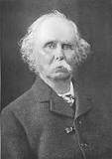
Principles of Economics — Alfred Marshall (1890)
(from the observation of “industrial districts”, not cities)
When an industry has chosen a locality for itself, it is likely to stay there long: so great are the advantages which people following the same skilled trade get from near neighborhood to one another.
The mysteries of the trade become no mysteries; but are as it were in the air, and children learn many of them unconsciously.
Good work is rightly appreciated, inventions and improvements in machinery, in processes and the general organization of the business have their merits promptly discussed: if one man starts a new idea, it is taken up by others and combined with suggestions of their own; and thus it becomes the source of further new ideas.
And presently subsidiary trades grow up in the neighborhood, supplying it with implements and materials, organizing its traffic, and in many ways conducing to the economy of its material.
Agglomeration Effects
Innovation, Growth
Economies of
Co-location
Principles of Economics,
book 4, ch 10: The Concentration of Specialized Industries in Particular Localities
Notes:
Economists often identify Alfred Marshall as the formal originator of “agglomeration effects”. His work is in the context of “industrial districts” not cities proper.

Slide 4
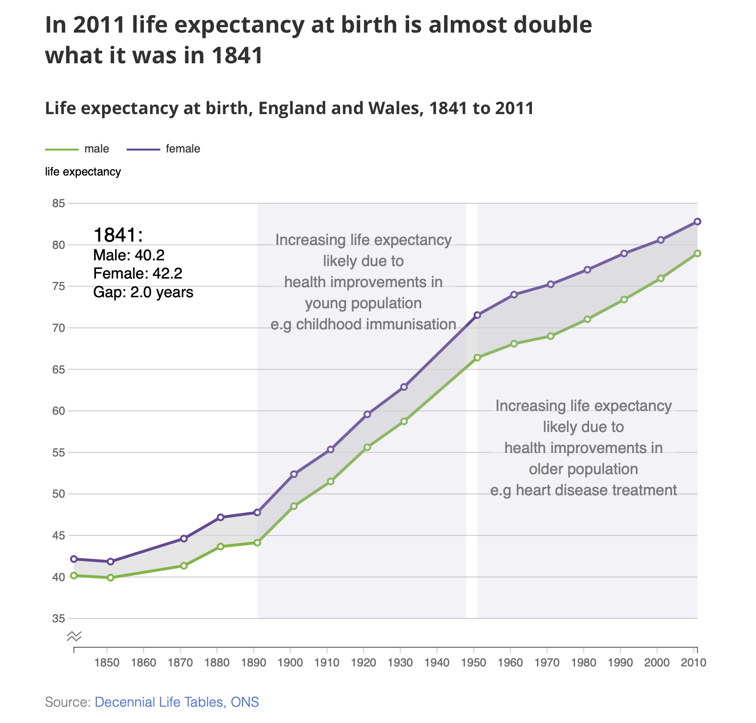
Communist
manifesto
https://www.ons.gov.uk/peoplepopulationandcommunity/birthsdeathsandmarriages/lifeexpectancies/articles/howhaslifeexpectancychangedovertime/2015-09-09

Slide 5
Marshall
Three Types of External Agglomeration Economies
In the language of Fujita, Venables & Krugman (reading)
1. Thick markets for specialized skills
2. Backward and Forward “linkages” for larger local markets
3. Knowledge Spillovers
increased productivity & less risk from labor specialization in larger networks
economies from larger consumer-producer co-locations
“home market effect”
learning from others and innovation as the social basis for economic growth
lead to (urban)
“Agglomeration Effects”
These are mechanistic arguments that can be modeled: what do they have in common?

Slide 6
Why cities form and persist? (Economics)
Externalities and Spillovers
Space and Transportation Costs
“Agglomeration Effects”
benefits
that go beyond economics
Cities
Notes:
This is the picture from economics, there are many more arguments along the lines of their importance for shared infrastructure (e.g. irrigation), ritual and religion, and defense that go well being economics (the feedback arrow) and that may be in many cases the main factors.

Slide 7
Can we demonstrate (some of) these effects in a model?
The Core-Periphery Model

Slide 8
The general structure of economic models (general equilibrium)
Jacobs : “Simple Models”
-Consumers:
Maximize “Utility” :
$$U(q,...)$$
The choice of $U$
determines the outcome
match
consumption=production
“offer=demand”
happiness, “subjective value”
$q:$ quantity of goods consumed
$$U$$
price of $q$:
$$p_{q}=\frac{dU}{dq}$$
concave:
$$\frac{d^{2}U}{dq^{2}}<0$$
$$q$$
subject to given budget:
$$y=p_{q}q+c$$
income = cost of $q$ plus all other costs
to get economy in
“equilibrium”
(nothing else happens)
-Firms:
budget constraint; ~ law of energy conservation
Maximize Profit …
but assume perfect competition zero profit
“free entry, free markets” no growth
cities
labor + other production costs = sales
spatial equilibrium
Notes:
This is a lightning introduction to global equilibrium models in Economics.

Slide 9
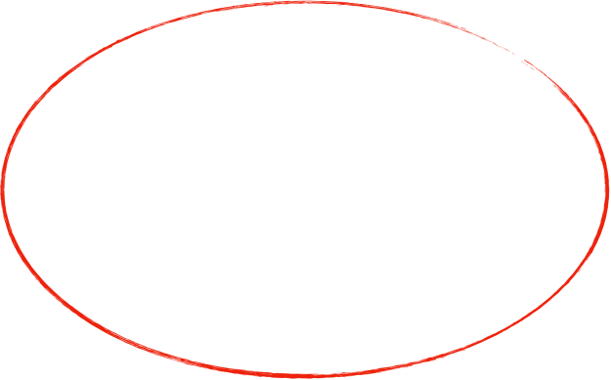
Economics Models about Cities
Urban Economics
Economic Geography
Monocentric City
Core-Periphery Model
Remember Alonso
tries to explain
how land rents and transportation costs
shape the city internally
how sector concentration, trade and transportation costs
vary between spatial regions
different scales: city versus regions (rural areas + cities)

Slide 10
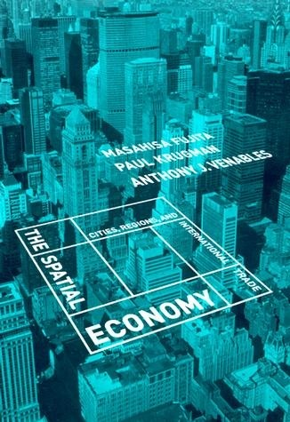
in your reading materials,
especially ch 4-5; IUS 2.1
detailed derivation of the math in this lecture

Slide 11
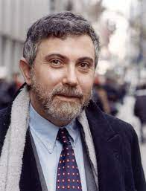
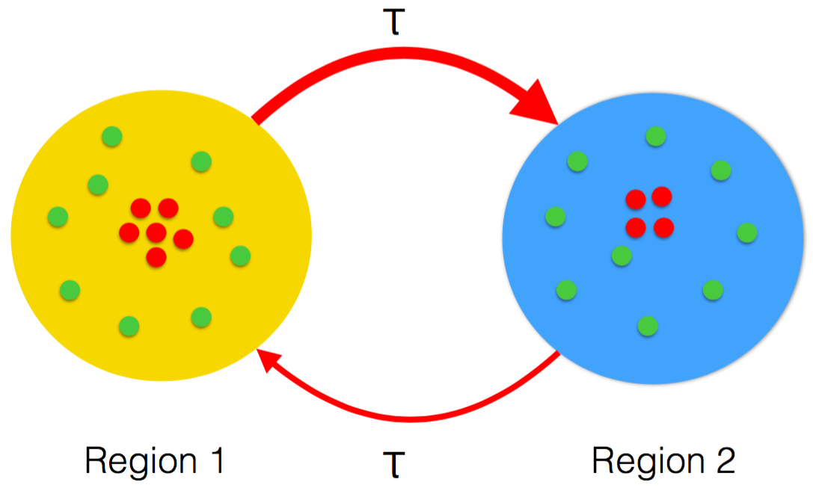
The Spatial Economy
[ Regional Economics ~ International Trade Theory ]
IUS 2.1.2
UChicago Expert
Esteban Rossi-Hansberg (Econ Dept)
“We would argue that the defining issue of economic geography is the need to explain concentrations of population and of economic activity: the distinction between manufacturing belt and farm belt, the existence of cities, the role of industry clusters. “
2008 Nobel in Economics
NYtimes columnist
manufacturing workers
farmers
As we vary transportation costs, will all the manufacturers concentrate (in the same region)?
Notes:
Krugman’s is the only Nobel Prize (Economics) for work on cities (so far).

Slide 12
Modeling Production-Consumption Linkages
(feedback loops)
Industrial producers want to choose locations that have good access to large markets and to supplies of goods that they and their workers need.
However, a place that for whatever reason already has a concentration of producers tends to offer a large market (because of the demand the producers and their workers generate) and a good supply of inputs and consumer goods (made by the producers already there).
producers
agglomeration
virtuous cycle
markets
Notes:
He only considers one channel for agglomeration effects, the co location of consumers and producers.

Slide 13
The Core Periphery Model
Krugman 1991
Nobel Prize Economics 2008
"By having integrated economies of scale into explicit general equilibrium models,
Paul Krugman has deepened our understanding of the determinants of trade and the location of economic activity."
Ingredients:
Agriculture
+
Manufacturing
single good
workers tied to the land
same wage everywhere
diversity of n goods
N workers can move
real wages vary between regions
$$ω_{r}$$
$$y_{w_{F}}=1$$
“numeraire”
workers go to where
they can consume more goods
agglomeration:
$${\overset{·}{f}}_{1}=(y_{ω_{1}}-y_{ω_{2}})f_{1}$$
sets the units of income
$$f_{1}=$$
fraction of workers in region r
$$n_{MF}$$
fraction of overall manufacturing workers to farmers
Problem: How to compute real wages in each region?

Slide 14
“Dixit-Stieglitz” Model with Space + Transportation Costs
Region 1
Region 2
share of expenditure
in manufacturing
Objective :
$$y_{ω_{1}}=y_{w_{1}}{\overline{p}}_{1}^{-n_{MF}}$$
$$y_{ω_{2}}=y_{w_{2}}{\overline{p}}_{2}^{-n_{MF}}$$
real wage
cost of living index
real wage
nominal wage
nominal wage
Nominal wages
$$y_{w_{1}}={\left[y_{1}{\overline{p}}_{1}^{σ_{S}-1}+y_{2}{\overline{p}}_{2}^{σ_{S}-1}T^{1-σ_{S}}\right]}^{1/{σ_{S}}}$$
$$y_{w_{2}}={\left[y_{1}{\overline{p}}_{1}^{σ_{S}-1}T^{1-σ_{S}}+y_{2}{\overline{p}}_{2}^{σ_{S}-1}\right]}^{1/{σ_{S}}}$$
transportation
Local Price index
$${\overline{p}}_{1}={\left[f_{1}y_{w_{1}}^{1-σ_{S}}+(1-f_{1})y_{w_{2}}^{1-σ_{S}}T^{1-σ_{S}}\right]}^{1/(1-σ_{S})}$$
$${\overline{p}}_{2}={\left[f_{1}y_{w_{1}}^{1-σ_{S}}T^{1-σ_{S}}+(1-f_{1})y_{w_{2}}^{1-σ_{S}}\right]}^{1/(1-σ_{S})}$$
Region’s Nominal Income
transportation
$$y_{1}=n_{MF}f_{1}y_{w_{1}}+\frac{1-n_{MF}}{2}$$
$$y_{2}=n_{MF}(1-f_{1})y_{w_{2}}+\frac{1-n_{MF}}{2}$$
wages of workers
wages of farmers
wages of workers
wages of farmers
solve 2 coupled equations: 3 input parameters: T, σS, nMF

Slide 15
What drives urbanization?
“taste for variety”
This is an assumption built into the model
1. Consumer behavior
$$p_{i}=\frac{dU}{dq_{i}}$$
$$c_{M}={\left(\sum_{i}^{n_{M}}{q_{i}^{(σ_{S}-1)/σ_{S}}}\right)}^{σ_{S}/(σ_{S}-1)}$$
$$q_{i}=n_{MF}Y\frac{p_{i}^{-σ_{S}}}{{\overline{p}}^{σ_{S}-1}}$$
What is $q_{i}$ as a function of $p_{i}?$
$$U=c_{M}^{n_{MF}}c_{F}^{1-n_{MF}}$$
demand curve
IUS Appendix A
index of diversity:
goes up with more products
$$\overline{p}={\left(\sum_{i=1}^{n_{M}}{p_{i}^{1-σ_{S}}}\right)}^{\frac{1}{1-σ_{S}}}$$
cost of living
Maximize Utility (~happiness)
will benefit from proximity to goods production
Maximize
subject to budget
$$p_{A}A+\overset{n}{\underset{i=1}{∑}}p_{i}q_{i}=Y$$
$$U$$
$$c_{M}=n_{M}^{\frac{σ_{S}}{σ_{S}-1}}q=n_{M}^{\frac{1}{σ_{S}-1}}\frac{Y}{p}$$
intuition from all q’s being the same
get more $c_{M}$ from
smaller $σ_{S}$, smaller price, larger budget
$$U$$
Utility goes up
with more products consumed
“taste for variety”
This is the “Agglomeration Force” in the model
$$n$$

Slide 16
2. Transportation Costs and nominal industrial incomes per region
for imported goods from other regions:
$$p_{i}→p_{i}T,T>1$$
“iceberg transportation costs”
prices are larger if product comes from another region
$$y_{1}=n_{MF}f_{1}y_{w_{1}}+\frac{1-n_{MF}}{2}$$
$$y_{2}=n_{MF}(1-f_{1})y_{w_{2}}+\frac{1-n_{MF}}{2}$$
income from wages
income from wages
income from farmers
income from farmers
$Y_{1},Y_{2}$: Total expenditure in region 1 or region 2
$$\frac{e_{11}}{e_{12}}=\frac{n_{M_{1}}}{n_{M_{2}}}\frac{p_{1}}{p_{2}T}\frac{q_{11}}{q_{12}}$$
$$\frac{e_{21}}{e_{22}}=\frac{n_{M_{1}}}{n_{M_{2}}}\frac{p_{1}T}{p_{2}}\frac{q_{21}}{q_{22}}$$
$$\frac{q_{11}}{q_{12}}={\left(\frac{p_{1}}{p_{2}T}\right)}^{-σ_{S}}$$
$$\frac{q_{21}}{q_{22}}={\left(\frac{p_{1}T}{p_{2}}\right)}^{-σ_{S}}$$
$$q_{11}∝p_{1}^{-σ_{S}}$$
local consumption in region 1
$$q_{12}∝(p_{2}T)^{-σ_{S}}$$
consumption of products
from region 2 in region 1
$e_{ij}^{Y}$ : fraction of expenditure from region i spent on j
$$Y_{W_{1}}=y_{w_{1}}n_{MF}f_{1}N=n_{MF}\left[\frac{e_{11}^{Y}}{e_{11}^{Y}+e_{21}^{Y}}Y_{1}+\frac{e_{21}^{Y}}{e_{21}^{Y}+e_{22}^{Y}}Y_{2}\right]$$
$Y_{W_{1}},Y_{W_{2}}:$ Total nominal wages in each region 1, 2
$$Y_{W_{2}}=y_{w_{2}}n_{MF}(1-f_{1})N=n_{MF}\left[\frac{e_{12}^{Y}}{e_{11}^{Y}+e_{21}^{Y}}Y_{1}+\frac{e_{22}^{Y}}{e_{21}^{Y}+e_{22}^{Y}}Y_{2}\right]$$

Slide 17

3. Manufacturing Firm Profit Maximization : relating prices to wages
labor
$$l=F+cq$$
$$r=1,2$$
max
$$π_{r}=p_{r}q_{r}-y_{w_{r}}(F+cq_{r})$$
$$p_{r}∝y_{w_{r}}$$
profits
labor costs
fixed costs
costs per product
profit maximization in each region:
$$\frac{dπ}{dq}=\frac{dp}{dq}q+p-cy_{w}=0$$
$$p∝q^{-\frac{1}{σ_{S}}},\frac{dp}{dq}=-\frac{1}{σ_{S}}\frac{p}{q}$$
from utility function
$$p=\frac{c}{1-1/σ_{S}}y_{w}$$
zero profits (“free entry”) condition
$$q_{1}=q_{2}=\frac{F}{c}(σ_{S}-1)$$
quantity produced per firm
is the same in each region
$$q=\frac{F}{c}(σ_{S}-1)$$
$$l_{1}=l_{2}=Fσ_{S}$$
labor in each firm is the same
$$\frac{n_{M_{1}}}{n_{M_{2}}}=\frac{N_{1}}{N_{2}}=\frac{f_{1}}{1-f_{1}}$$
the manufacturing population is proportional
to products in each region

Slide 18
“Dixit-Stieglitz” Model with Space + Transportation Costs
Region 1
Region 2
share of expenditure
in manufacturing
Objective :
$$y_{ω_{1}}=y_{w_{1}}{\overline{p}}_{1}^{-n_{MF}}$$
$$y_{ω_{2}}=y_{w_{2}}{\overline{p}}_{2}^{-n_{MF}}$$
real wage
cost of living index
real wage
nominal wage
nominal wage
Nominal wages
$$y_{w_{1}}={\left[y_{1}{\overline{p}}_{1}^{σ_{S}-1}+y_{2}{\overline{p}}_{2}^{σ_{S}-1}T^{1-σ_{S}}\right]}^{1/{σ_{S}}}$$
$$y_{w_{2}}={\left[y_{1}{\overline{p}}_{1}^{σ_{S}-1}T^{1-σ_{S}}+y_{2}{\overline{p}}_{2}^{σ_{S}-1}\right]}^{1/{σ_{S}}}$$
transportation
Local Price index
$${\overline{p}}_{1}={\left[f_{1}y_{w_{1}}^{1-σ_{S}}+(1-f_{1})y_{w_{2}}^{1-σ_{S}}T^{1-σ_{S}}\right]}^{1/(1-σ_{S})}$$
$${\overline{p}}_{2}={\left[f_{1}y_{w_{1}}^{1-σ_{S}}T^{1-σ_{S}}+(1-f_{1})y_{w_{2}}^{1-σ_{S}}\right]}^{1/(1-σ_{S})}$$
Region’s Nominal Income
transportation
$$y_{1}=n_{MF}f_{1}y_{w_{1}}+\frac{1-n_{MF}}{2}$$
$$y_{2}=n_{MF}(1-f_{1})y_{w_{2}}+\frac{1-n_{MF}}{2}$$
wages of workers
wages of farmers
wages of workers
wages of farmers
solve 2 coupled equations: 3 input parameters: T, σS, nMF

Slide 19
Solve for
$$y_{ω_{1}}-y_{ω_{2}}=g(f_{1}|T,n_{MF},σ_{S})$$
strength of taste for variety
difference in real wages between regions
fraction of workers
in region 1
fraction of manufacturing workers
to population
transportation costs
Python code provided : next weeks assignment
Notes:
This and the preceding slides are better explained in the book (and in Krugman’s papers)

Slide 20
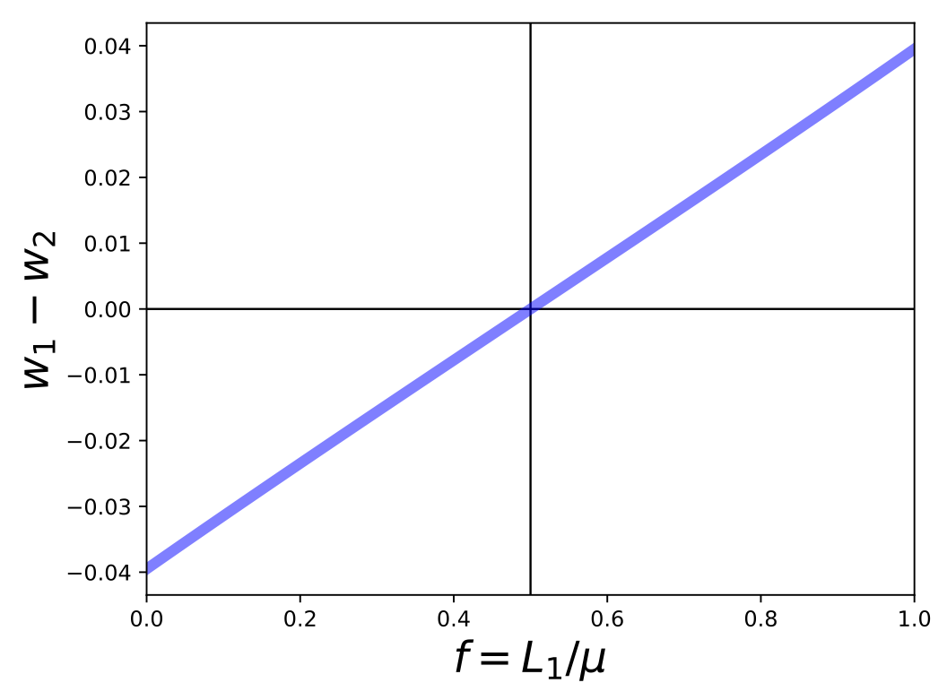
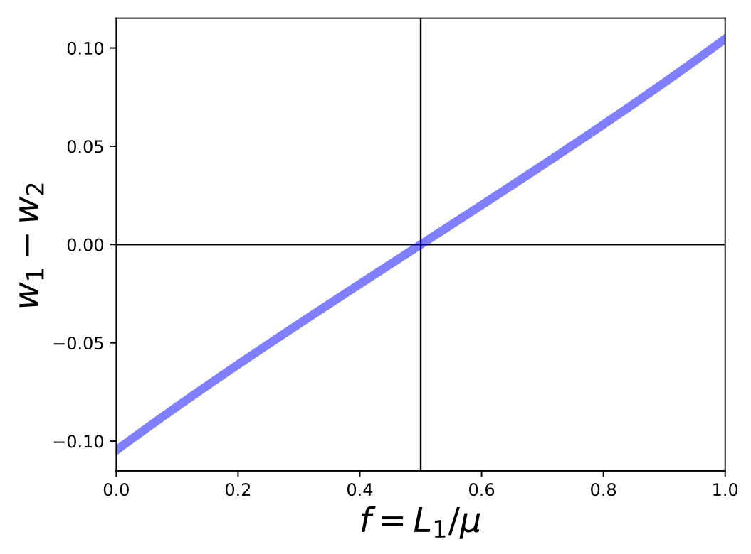
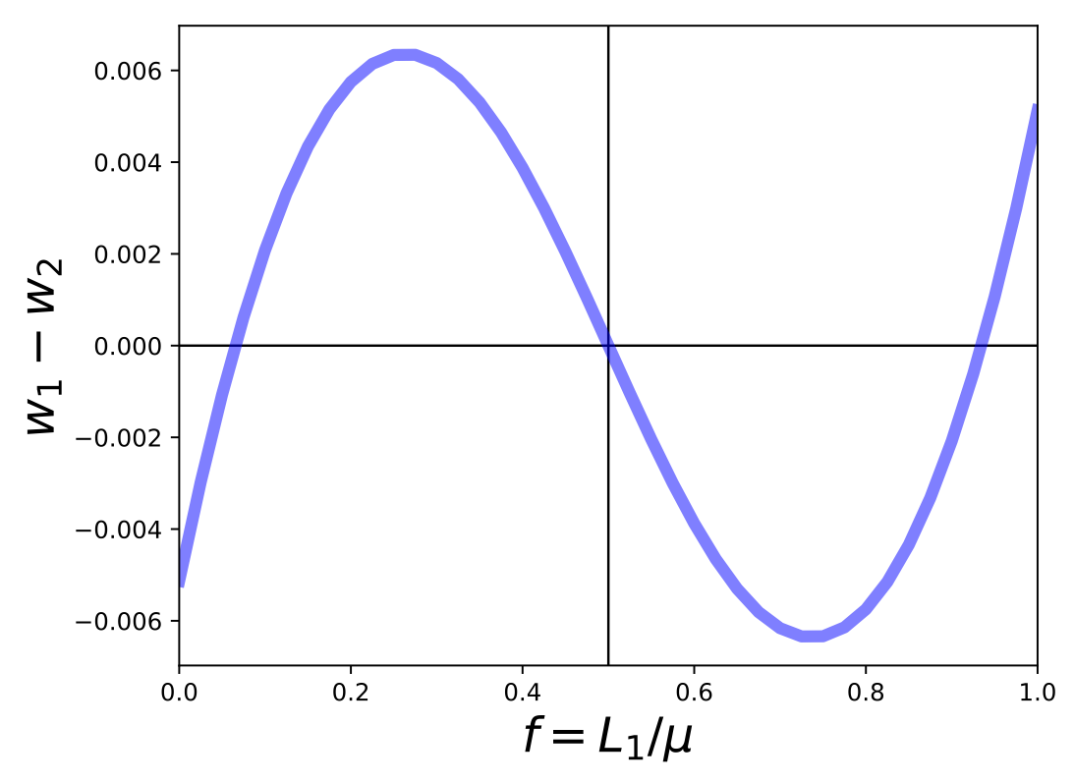
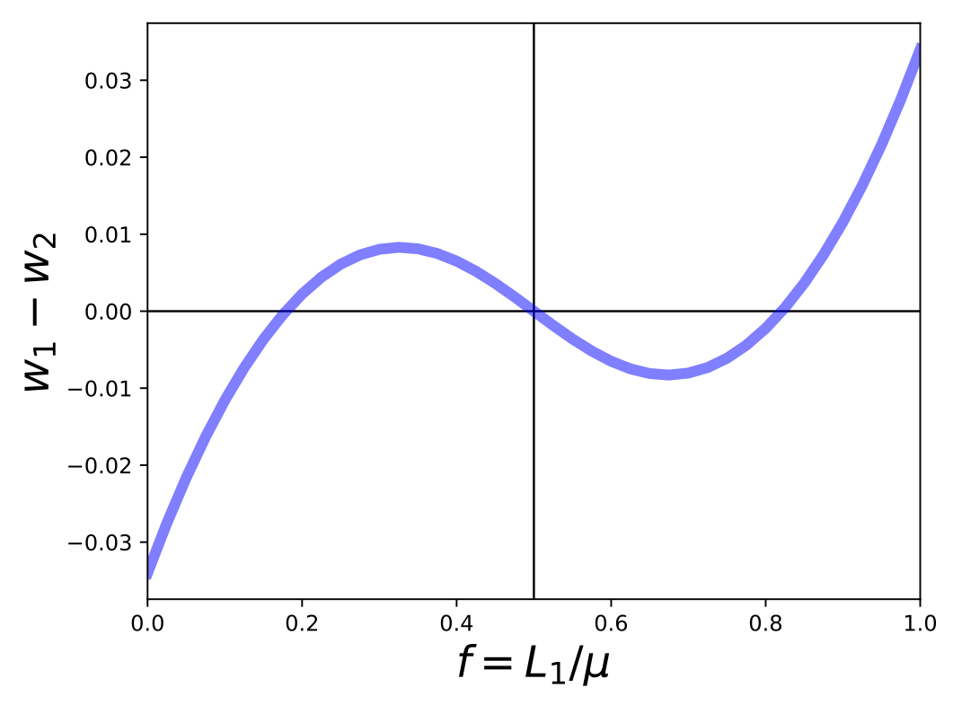
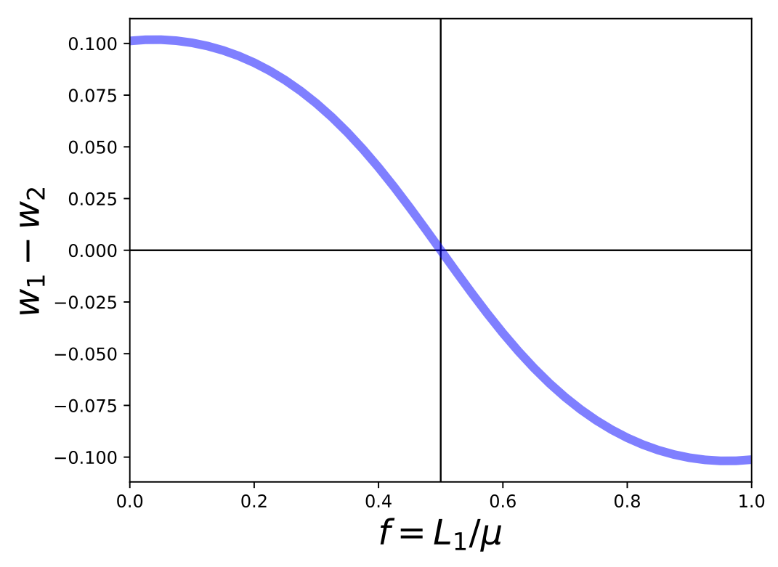
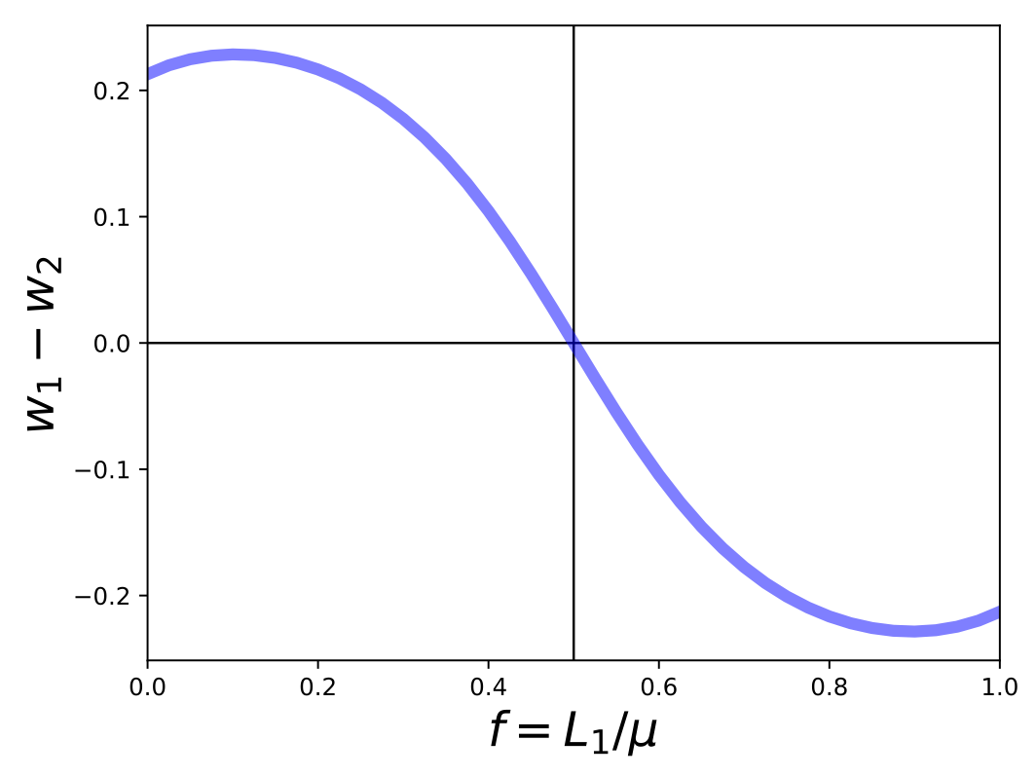
A.
B.
$$n_{MF}=0.3$$
flow
$$n_{MF}=0.4$$
$$T=1.3$$
$$σ_{S}=4$$
$$σ_{S}=4$$
agglomeration
$$T=1.1$$
$$T=1.7$$
$$T=2.1$$
$$y_{ω_{1}}-y_{ω_{2}}$$
$$y_{ω_{1}}-y_{ω_{2}}$$
$$T=2.2$$
$$T=4.1$$
dispersion
$$f_{1}$$
$$f_{1}$$
Fraction of Workers in Region 1
Notes:
It is important to understand these results, and help students read these graphs.

Slide 21
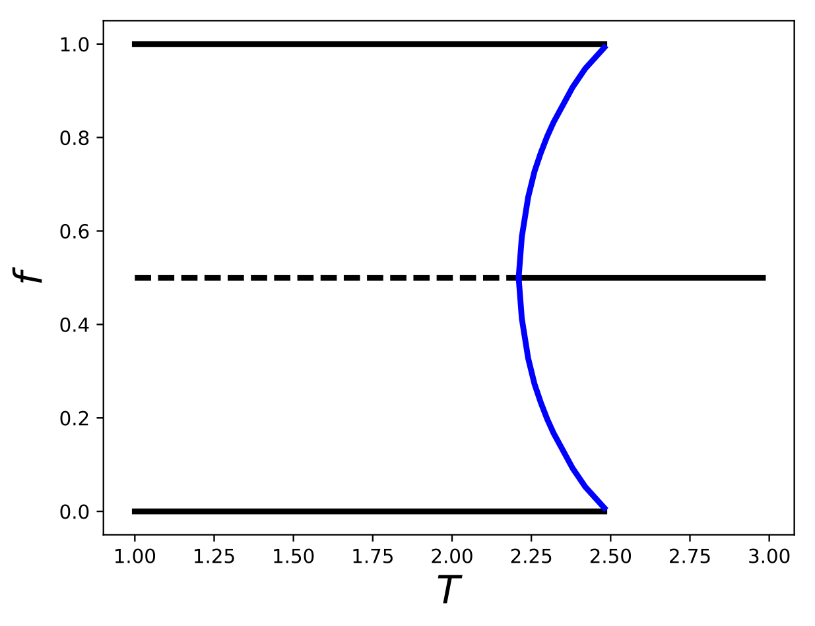
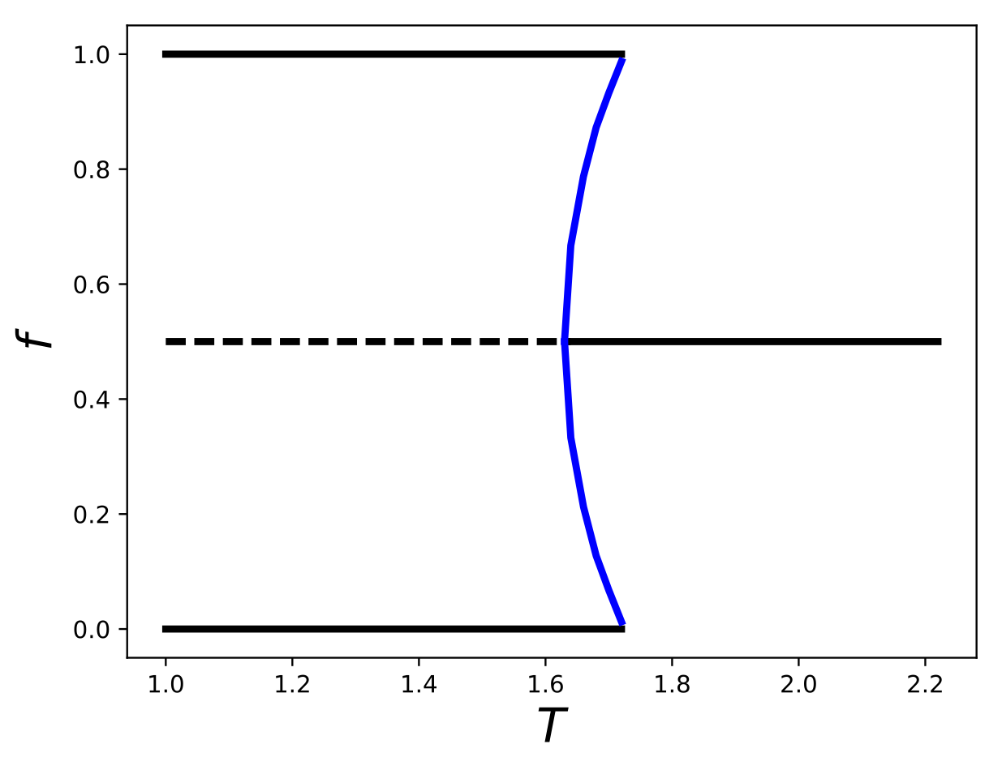
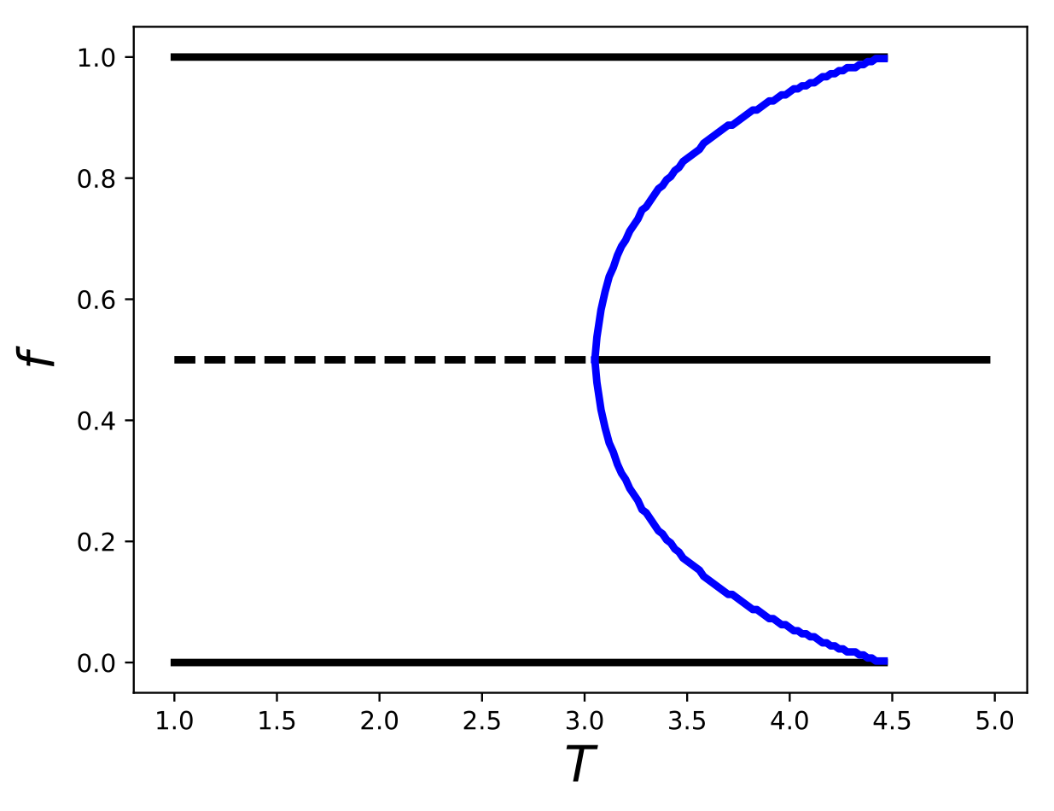
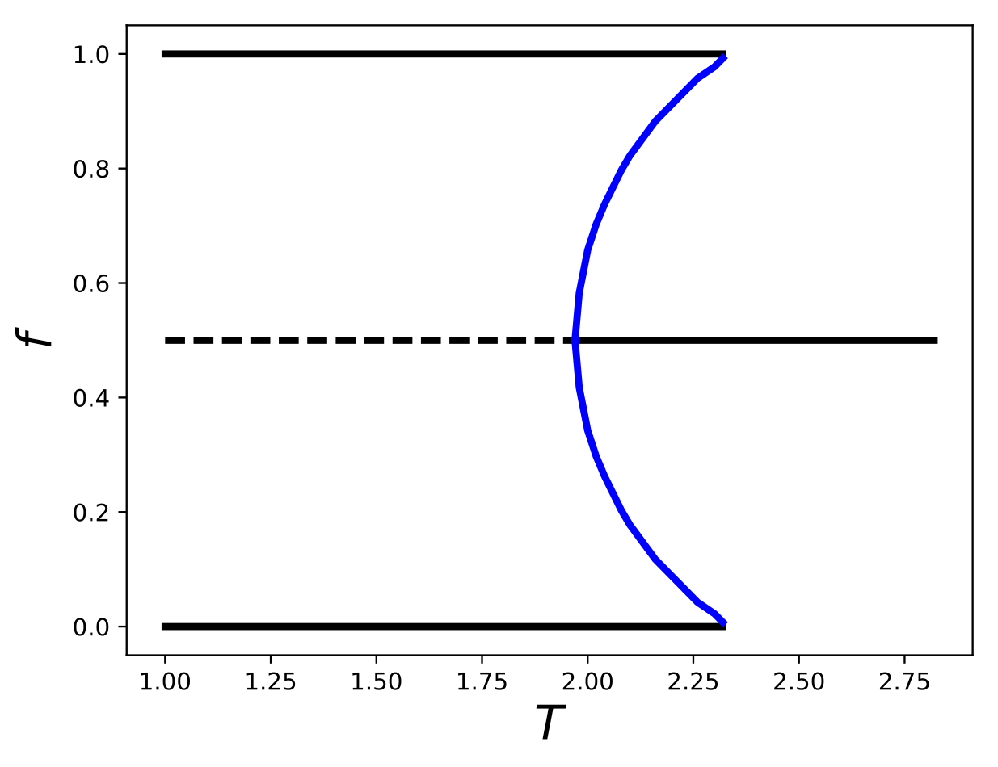
hysteresis
Stable: Agglomeration
$$n_{MF}=0.3$$
$$n_{MF}=0.3$$
$$σ_{S}=3$$
$$σ_{S}=4$$
$$f_{1}$$
$$f_{1}$$
Stable: Dispersion
$$T_{*}={\left[\frac{σ_{S}(1+n_{MF})-1}{σ_{S}(1-n_{MF})-1}\left(\frac{1+n_{MF}}{1-n_{MF}}\right)\right]}^{1/(σ_{S}-1)}$$
$$σ_{S}≥\frac{1}{1-n_{MF}}$$
$$n_{MF}=0.4$$
$$n_{MF}=0.4$$
$$σ_{S}=3$$
$$σ_{S}=4$$
$$f_{1}$$
$$f_{1}$$
Stable: Agglomeration
below: always agglomeration

Slide 22
Summary
Forces that link Production <—> Consumption with transportation costs
can generate spontaneous spatial agglomeration via feedback loops for:
lower transport costs
higher ratio of manufacturing workers to farmers
lower substitutability
Sudden “phase transition” triggered by difference in real wages over space.
$$T$$
$$n_{MF}$$
$$σ_{S}$$

Slide 23
General Properties of Core-Periphery Models and Generalizations:
Home-market effects: the disproportional location of industry due to demand change,
Circular causality (equilibrium): whereby larger industry concentrations beget higher real incomes and vice-versa,
Emerging asymmetries between regions, in that workers and firms concentrate in one region versus another,
Discontinuous agglomeration: small changes in parameters result in sudden agglomeration in a single region,
Degenerate equilibria: which region ends up agglomerating depends on choices and history, this is connected to path-dependence.
Hysteresis: dispersion can persist temporarily even as transportation costs fall below the critical point, and the same is true starting with agglomeration as transportation costs rise.

Slide 24
Zooming out, Questions:
Think of Jacobs, Addams, Du Bois, Park + Burgess, Wirth
Think of Marshall
- What effects do these Economic Models capture?
- What effects do Economic Models NOT capture?
For example:
How can we understand specialization or diversity?
IUS Ch 5
How can we understand diversity and neighborhoods
IUS Ch 4 & 6
knowledge spillovers, innovation?
IUS Ch 5 & 9

